Slide 1
Social Engineering
To know how psychological understanding affect IT security; the human factor; social engineering; phishing; fake mails etc.
Tue Becher

Slide 2
Risk perception
Is subjective
Individuals must make many decisions each day
Assess the situation
Weight potential alternatives
Make decision
Act on their decision
Is it OK to cross the street now?

Slide 3
Exercise
You have all read about risk perception
Discussion in groups
What topics seems to be repeated when talking about perception of risks?
What are the main features of risk perception?
Did you all a have the same comprehension of risk perception?
Was there anything that surprised you?

Slide 4
Trust
The act of committing to an exchange before it is known how the other party will act
In order for trust to occur:
must be some uncertainty about future course of actions
actions of the parties involved in the situation must have the ability to affect outcomes
potential negative outcomes must be of greater magnitude than the potential positive outcomes
No trust needed if nothing to loose

Slide 5
Online shopping
Service provider is responsible for the security
The shopping process is defined by the designer of the web pages.
Few general rules for online purchase systems:
indicate quantity, value and/or description of products.
get relevant personal data from the customer
encrypt transmission of data (normally SSL)

Slide 6
Online shopping – Trust
The consumer must trust:
The quality of goods and services
That the product or service will be delivered
The server (the manufacturer) with the credit card transaction
The technology involved in establishing and maintaining security and privacy in the transaction
That a return policy is honoured if the product is damaged, defective, or unacceptable
…

Slide 7
Exercise – Online shopping
Discuss in groups how social and cultural variables may influence on the perception of risks using a online shopping system.
The system admin
Person updating the system via CMS interface
Potential customers
Carpenter
Computer programmer
Lawyer
…

Slide 8
Road map
What is risk perception?
What can influence on risk perception?
What can we do to make users feel safe?

Slide 9

Security update
http://watchguardsecuritycenter.com/

Slide 10
Social engineering
Older than computers
Targets the human component of a network
Goal
Obtain confidential information
Obtain personal information
Social engineering is an art of utilising human behaviour to breach security – Gultai, 2003 –

Slide 11
Social engineering cont.
Maybe the single largest security threat to networks
Very hard to protect against
Main idea:
”Why crack a hard password when you can ask for it?”
Users will disclose their passwords to IT personnel

Slide 12
Comments from Kevin Mitnick
”The weakest link in the security chain is the human element”
In more than 50% of his successful exploits he gained info or access through social engineering
”You could spend a fortune purchasing technology and services… and your network infrastructure could still remain vulnerable to old-fashioned manipulation”

Slide 13
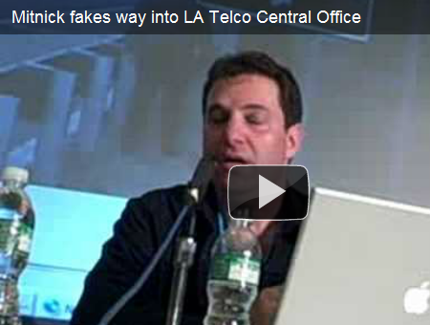
From ”The art of Deception”
”People inherently want to be helpful and therefore are easily duped”
”They assume a level of trust in order to avoid conflict”
”It’s all about, gaining access to information that people think is innocuous when it isn’t”
https://www.youtube.com/embed/8L76gTaReeg?rel=0&autoplay=1&showinfo=0&%C2%ADcontrols=0&HD=1

Slide 14
Social engineering Tactics
Two types:
Human based deception
Technology based deception
Rely on:
Persuasion, intimidation,…
Understanding human behaviour
Recognition of personality traits
Understanding of body language

Slide 15
Tactics – Piggybacking
The social engineer will pose as a legitimate employee and follow behind someone who has access.
Carrying a heavy box – exploit an employees kindness: ”Mind opening the door for me – can’t reach my access card carrying this box”
Join a group of employees standing outside to smoke. Bypass card readers by walking right behind them when they are done smoking.

Slide 16
Tactics – Reverse social engineering
3 steps – the social engineer will:
Find a way to sabotage a system (or give the impression)
Network attack, spoofed email informing of virus, …
Advertise himself as a security consultant who can help
Advertising by phone, email, …
Once hired by the corporation he will pretend to fix the problem – while he actually perform malicious activities.
Copy data, deploy key loggers, create security holes,…

Slide 17
Tactics – Technical talk
The social engineer will call an employee and impersonate someone from the technical department.
”Hi, calling from IT. We lost a backup file and your password may have been compromised – I’d like to help you change it”
Ohh, what should I do?
”Please press Ctrl-Alt-Del buttons at the same time – should bring up a window with a Change Password button. Now remember to create a secure pass mixing upper and lower case with numbers. That will make it hard to hack your computer. What password are you going to use?”
Don’t know – would ”Peter88” be ok?
”Yes, that should be just fine – type it in and press OK. Thanks for taking the time to keep your computer safe”

Slide 18
Tactics – Online social media
The social engineer will find loads of possibilities in social networks such as Facebook
People reveal info on work, friends, interests, where they will be next Friday evening, ….
Can be used in many ways
Imposing as a victims friend
Fake email from a friend found on the friends list
Lots of info for making spear phishing attacks
Add victim as a friend to build up trust
Meet the victim outside a work environment
Friday evening – drinking alcohol, sharing secrets…

Slide 19
Tactics – Phishing
The social engineer will trick a victim out of sensitive information by claiming to come from a well-known organization.
Phishing:
Mass email possible victims
The mail includes a link to a fake website
Fake website collects sensitive information
www.phishtank.com
clearing house for data and info about phishing on the Internet
API for developers / download database

Slide 20
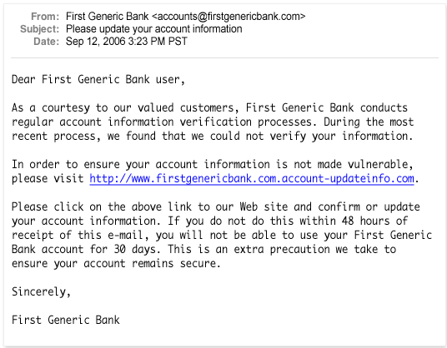
Tactics – Phishing email
How to tell?
Generic greetings, forged link, request personal info, sense of urgency

Slide 21
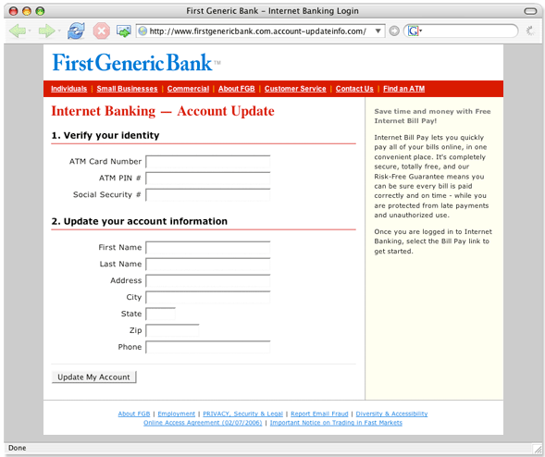
Tactics – Phishing website
How to tell?
URL domain
Request personal info
Non-secure protocol
Poor quality

Slide 22
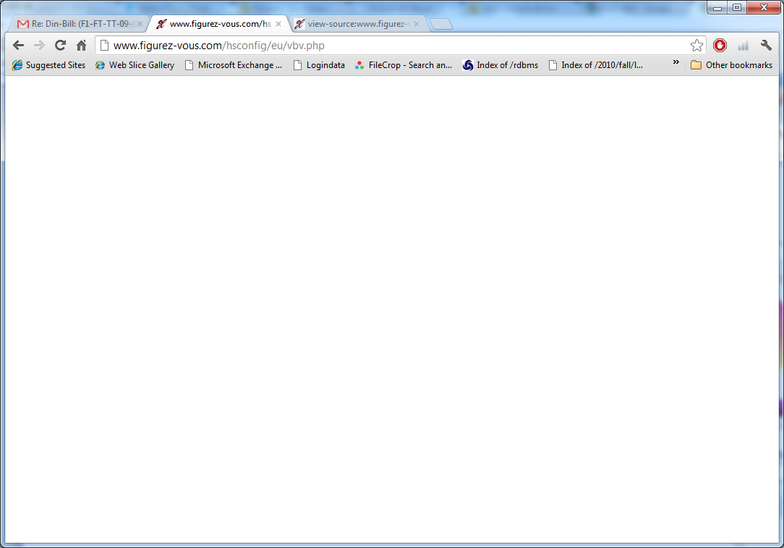
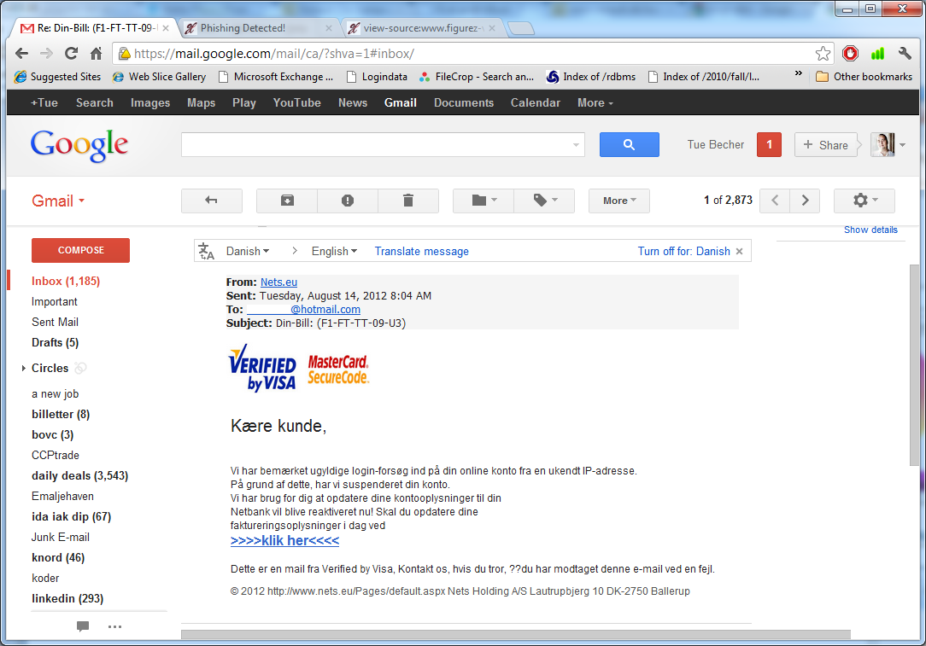
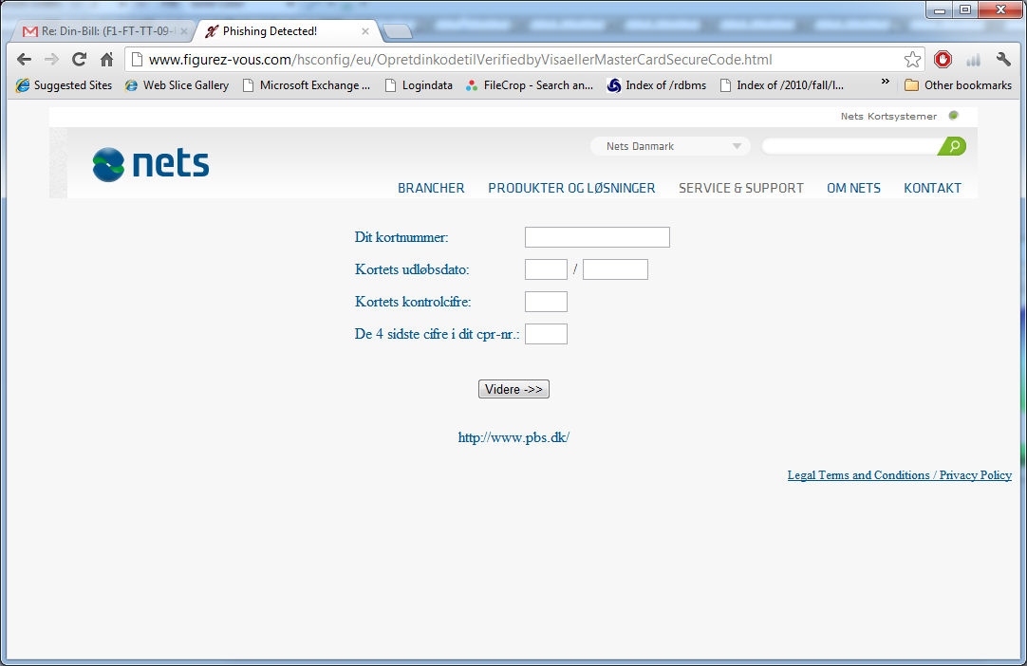

Example attack on nets

Slide 23
Tactics – Spear phishing
Same idea as phishing, but including known personal information such as name and address of the victim.
Target is a particular company, organization or group
Search out target employees names and mail addresses
Send a mail appearing to come from someone who would normally send to the everyone in the group.
Head of department, IT support, …
Focus is usually revealing login credentials or opening a malicious attachment

Slide 24
Tactics – Whaling
The most focused type of phishing
Targets are individuals or small groups senior personnel
The social engineer searches for info on executive officers
Many companies have bios on executive officers on their website
Some bios include hobbies
Example:
a bio contains university, graduation year and mentions an interest in golf.
The social engineer creates an email appearing to come from the university alumni, inviting him to a special alumni golf tournament.
The victim will be likely to believe that the invitation is authentic and open a malicious attachment

Slide 25
Tactics – Vishing
Vishing = Voice over IP (VoIP) + Phishing
War dialer calls a range of phone numbers and play a recorded message
”This is your bank, sorry to inform that your credit card may be compromised. Please call xx to resolve the issue”
The victim calls the number and a new recording ask the victim to input social security number, credit card number, etc.
Also examples of SMS initialised vishing

Slide 26
Exercise
Discuss the rules needed to prevent
Piggybacking
Reverse social engineering
Technical talk
Online social media
Phishing / spear phishing / whaling
Vishing
Compile your recommendations on defence against social engineering

Slide 27
Preventing Social Engineering
Security drills – train how to look out for suspicious people, e-mails, and phone calls
Verify caller identity – Ask questions and call back to confirm
Train Common Sense Security
Train employees not to reveal information to outsiders
Think before you post in social networking sites
Don’t drink and discuss work topics with strangers
Use the need-to-know principle
Only give employees enough info to do their job
No info on hi-level decisions that do not relate to their work
Maintain a healthy level of paranoia and common sense.
All of your fine recommendations

Slide 28
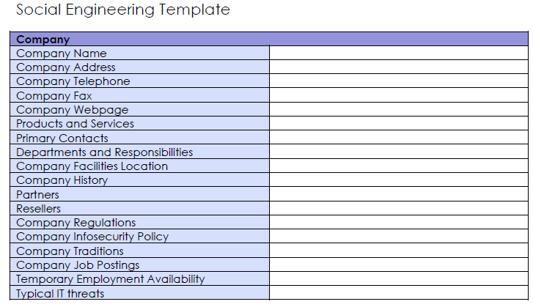
OSSTMM
Open Source Security Testing Methodology Manual
- a methodology for performing security tests and metrics

Slide 29
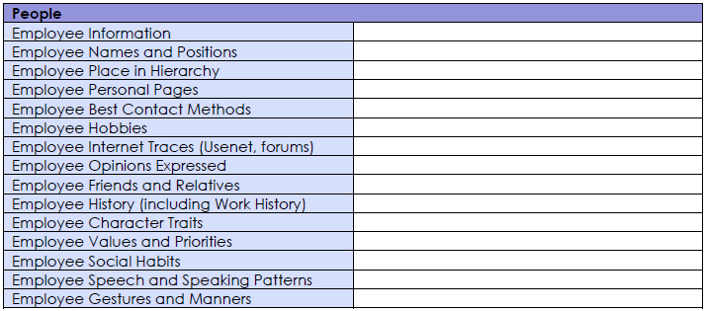
OSSTMM

Slide 30
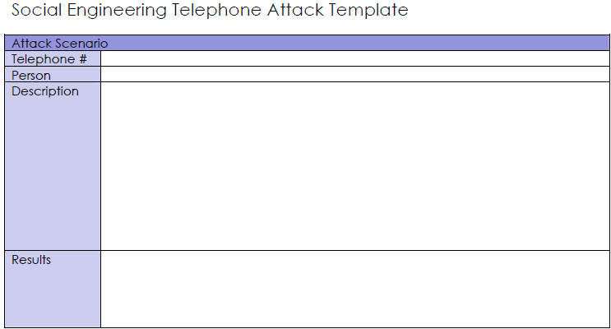
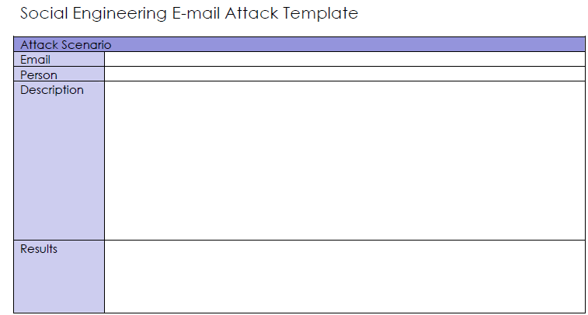
OSSTMM

Slide 31
Other areas

Slide 32
Shoulder surfing
Reading what a user enter on a keyboard
Logon names
Passwords
Pin codes
Tools
Telescopes, cameras in mobile phones, …
Knowledge
Key position and typing techniques
Popular letter substitutions
s = $, a = @, L = 1, …

Slide 33
Preventing shoulder surfing
Avoid typing sensitive information
When someone is nearby
When someone close is talking on mobile phone
Face monitors away from doors
Change password if you suspect someone has been observing you.

Slide 34
Dumpster Diving
Social engineer searching for info in victim’s trash
Discarded hardware
Old hard drives or backup media may contain sensitive data
Computer manuals
May have passwords or sensitive notes written in them
Phone lists
Calendars with schedules
Financial reports
Bills
…

Slide 35
Preventing dumpster diving
Educate employees about dumpster diving
Ensure proper trash disposal
Use a disk wiper to erase old hard drives before disposal
Avoid data recovery by overwriting all data
(using several passes)
Discard manuals off site
Shred documents before disposal

Slide 36
Exercise
Complete your recommendations
Prevention of shoulder surfing
Dumpster Diving
Search the net for other areas…

Slide 37

CAPTCHA
Completely Automated Program to Tell Computers and Humans Apart
Using human perception
Avoid automated comment spam in blogs
Protect registration pages
Secure online polls
Prevent dictionary attacks on passwords

Slide 38

CAPTCHA cont.
Widespread usage – many millions solved each day
Easy CAPTCHAs can be solved using character recognition
Modern versions may focus on making segmentation difficult by adding an angled line
Current software is unable to solve accurately

Slide 39
Perhaps there is another way…
Any ideas?

Slide 40
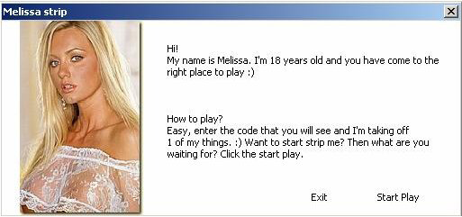
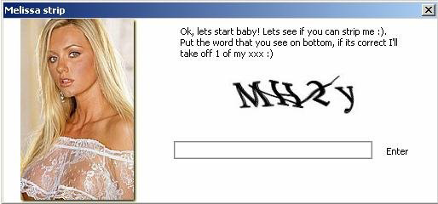
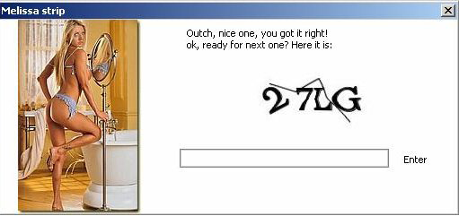
Helpful humans are around…

Slide 41
Assignment for next week
What have your organization/workplace done to be able to handle Social Engineering?
Describe existing procedures (short)
Suggest how the security regarding Social Engineering could be improved.
(no hand-in: is to be used as basis for discussion next week)

Slide 42
Till next time
Info / literature / links on Fronter – keep updated!!!
Reading:
https://en.wikipedia.org/wiki/Firewall_(computing)
Understanding the Basic Security Concepts of Network and System Devices - Firewalls.pdf (on fronter)
Strengthen network defenses by using a DMZ
http://www.techrepublic.com/article/solutionbase-strengthen-network-defenses-by-using-a-dmz/
IDS/IPS:
https://en.wikipedia.org/wiki/Intrusion_detection_system
NIST Special Publication 800-94 (Section 2+3)
http://csrc.nist.gov/publications/nistpubs/800-94/SP800-94.pdf
WAF: OWASP - Best Practices: Use of Web Application Firewalls
http://www.owasp.org/index.php/Category:OWASP_Best_Practices:_Use_of_Web_Application_Firewalls
Further reading:
http://www.ify.gr/documents/yia/yia/etairoi/Tourkia/Zone-Based%20Firewalls%20quik.pdf

